Slide 1

Database Management Systems
Shamim Ahmad

Slide 2
Examples of SQL statements

Slide 3
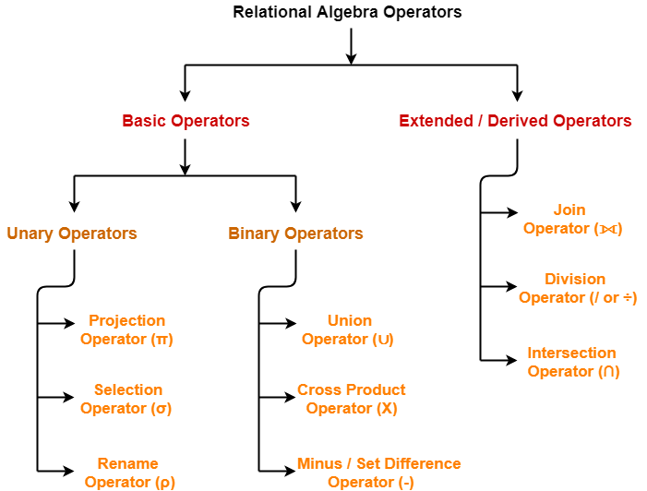

Slide 4
Projection (π) → picks columns.
Selection (σ) → picks rows (tuples) based on conditions

Slide 5
Select and Project Operation
SELECT (σ)
The SELECT operation is used for selecting a subset of the tuples (Horizontal subset ?) according to a given selection condition.
Select operator selects tuples that satisfy a given predicate
Projection(π)
The projection eliminates all attributes of the input relation but those mentioned in the projection list. The projection method defines a relation that contains values for a list all attributes (vertical subset ?) of Relation.
.
Source: https://www.guru99.com/relational-algebra-dbms.html#2

Slide 6
Roll | Name | Department | Fees | Team
1 | Bikash | CSE | 22000 | A
2 | Josh | CSE | 34000 | A
3 | Kevin | ECE | 36000 | C
4 | Ben | ECE | 56000 | D
Select all the student of Team A :
σ _{Team = 'A'} (Student)
Roll | Name | Department | Fees | Team
1 | Bikash | CSE | 22000 | A
2 | Josh | CSE | 34000 | A

Slide 7
Roll | Name | Department | Fees | Team
1 | Bikash | CSE | 22000 | A
2 | Josh | CSE | 34000 | A
3 | Kevin | ECE | 36000 | C
4 | Ben | ECE | 56000 | D
Select all the students of department ECE whose fees is greater then equal to 10000 and belongs to Team other than A.
σ _{Fees >= 10000}(σ_{Class != 'A'} (Student))

Slide 8
Roll | Name | Department | Fees | Team
1 | Bikash | CSE | 22000 | A
2 | Josh | CSE | 34000 | A
3 | Kevin | ECE | 36000 | C
4 | Ben | ECE | 56000 | D
Select all the students of department ECE whose fees is greater then equal to 10000 and belongs to Team other than A.
σ _{Fees >= 10000}(σ_{Class != 'A'} (Student))
Roll | Name | Department | Fees | Team
3 | Kevin | ECE | 36000 | C
4 | Ben | ECE | 56000 | D

Slide 9
CustomerID | CustomerName | Status
1 | Google | Active
2 | Amazon | Active
3 | Apple | Inactive
4 | Alibaba | Active
Π _{CustomerName, Status} (Customers)
CustomerName | Status
Google | Active
Amazon | Active
Apple | Inactive
Alibaba | Active
Source: https://www.geeksforgeeks.org/

Slide 10
StudentID | Name | Department | GPA
1 | Alice | CSE | 3.8
2 | Bob | EEE | 3.5
3 | Charlie | CSE | 3.9
4 | Diana | BBA | 3.6
SELECT Name FROM Students;

Slide 11
StudentID | Name | Department | GPA
1 | Alice | CSE | 3.8
2 | Bob | EEE | 3.5
3 | Charlie | CSE | 3.9
4 | Diana | BBA | 3.6
SELECT Name FROM Students;
Name
Alice
Bob
Charlie
Diana

Slide 12
StudentID | Name | Department | GPA
1 | Alice | CSE | 3.8
2 | Bob | EEE | 3.5
3 | Charlie | CSE | 3.9
4 | Diana | BBA | 3.6

Slide 13
StudentID | Name | Department | GPA
1 | Alice | CSE | 3.8
2 | Bob | EEE | 3.5
3 | Charlie | CSE | 3.9
4 | Diana | BBA | 3.6
SELECT Name, Department FROM Students;
Name | Department
Alice | CSE
Bob | EEE
Charlie | CSE
Diana | BBA

Slide 14
StudentID | Name | Department | GPA
1 | Alice | CSE | 3.8
2 | Bob | EEE | 3.5
3 | Charlie | CSE | 3.9
4 | Diana | BBA | 3.6
SELECT *
FROM Students
WHERE Department = 'CSE';

Slide 15
StudentID | Name | Department | GPA
1 | Alice | CSE | 3.8
2 | Bob | EEE | 3.5
3 | Charlie | CSE | 3.9
4 | Diana | BBA | 3.6
SELECT * FROM Students WHERE Department = 'CSE';
StudentID | Name | Department | GPA
1 | Alice | CSE | 3.8
3 | Charlie | CSE | 3.9

Slide 16
StudentID | Name | Department | GPA
1 | Alice | CSE | 3.8
2 | Bob | EEE | 3.5
3 | Charlie | CSE | 3.9
4 | Diana | BBA | 3.6
SELECT *
FROM Students
WHERE GPA > 3.6;
StudentID | Name | Department | GPA
1 | Alice | CSE | 3.8
3 | Charlie | CSE | 3.9

Slide 17
Operations on Tables

Slide 18
1. DELETE
Removes specific rows from a table (can use WHERE clause).
Data is deleted, but the table structure remains.
It is a DML (Data Manipulation Language) command.
Transaction can be rolled back (if within a transaction).
Slower than TRUNCATE (removes row by row).
Example:
DELETE FROM Students WHERE City = 'Dhaka';
Removes only rows where City = ‘Dhaka’.Table Students still exists, with other rows intact

Slide 19
2. TRUNCATE
Removes all rows from a table (no WHERE clause allowed).
Table structure remains, so you can still insert data later.
It is a DDL (Data Definition Language) command.
Cannot delete specific rows.
Faster than DELETE (does not log individual row deletions).
Cannot usually be rolled back (depends on DBMS, but in SQL Server/Oracle it’s not reversible once executed outside a transaction)
TRUNCATE TABLE Students;
Removes all rows from Students.
Table Students still exists, but it’s now empty.

Slide 20
DROP
Removes the entire table (structure + data).
It is a DDL command.
Once dropped, the table is gone permanently (unless restored from backup).
Cannot be rolled back (outside of transactional support).
Example:
DROP TABLE Students;
The table Students is completely deleted (data + structure).
You cannot insert into it anymore unless you recreate it.

Slide 21
Set Operation

Slide 22
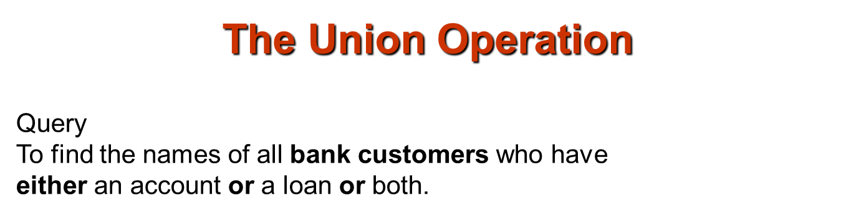
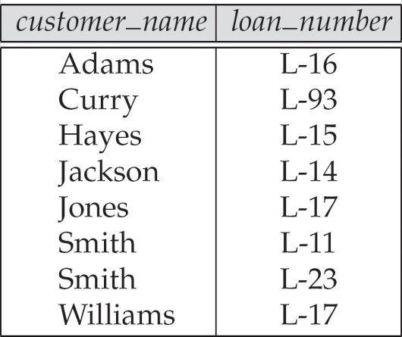
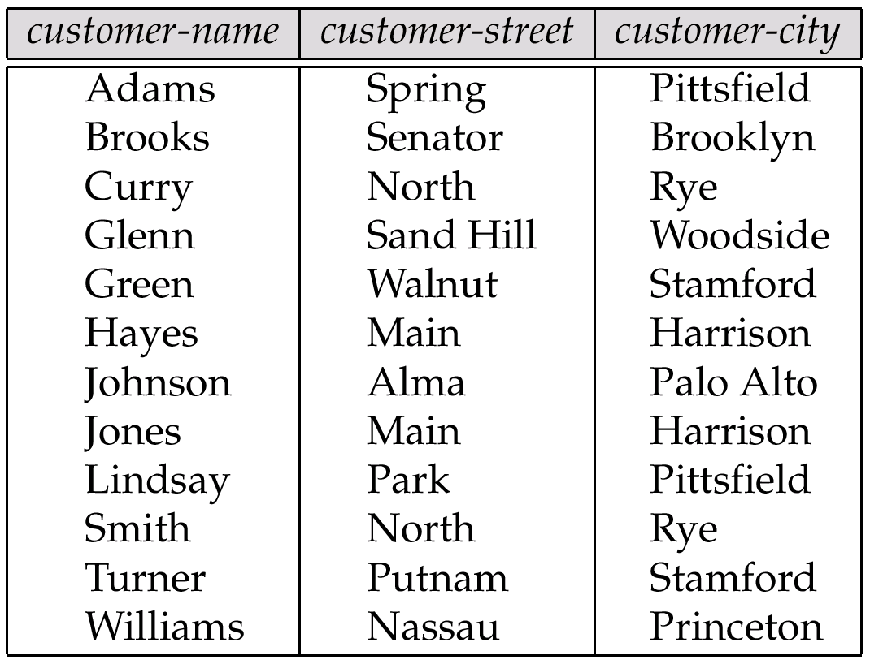
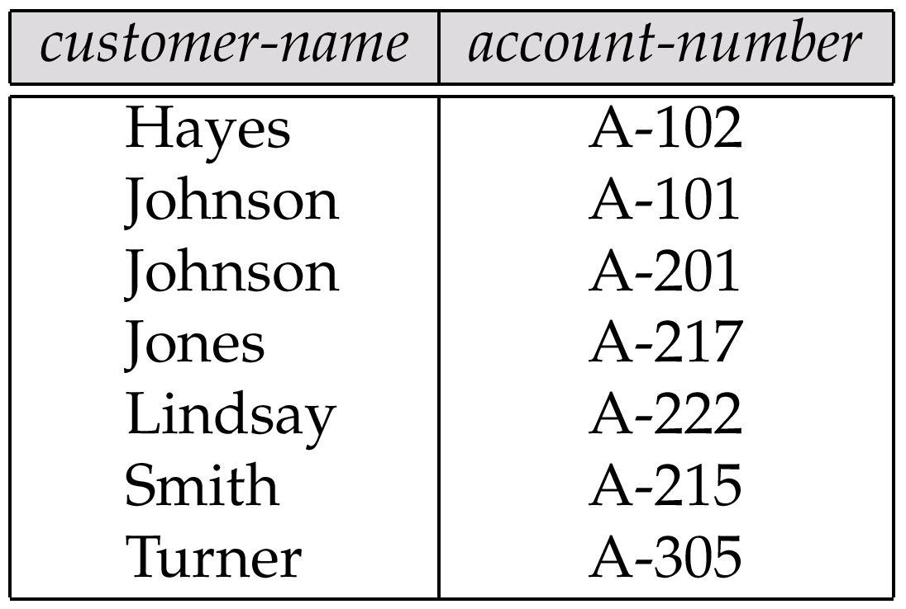
The borrower relation
The customer Relation
The depositor Relation

Slide 23
The borrower relation
The depositor Relation
The customer Relation
Πcustomer-name (borrower )
Πcustomer-name (depositor)

Slide 24
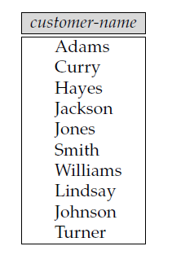

Example Queries
Find the names of all customers who have a loan, an account, or both, from the bank
∏_{customer_name} (borrower) ∪ ∏_{customer_name} (depositor)
The borrower relation
The depositor Relation

Slide 25
SELECT * FROM Info UNION SELECT * FROM Demo;
Explanation:
UNION combines the results of two SELECT queries. It removes duplicate rows from the final result set (if you want duplicates, you’d use UNION ALL).
For UNION to work:
Both queries must select the same number of columns.
The data types in each corresponding column must be compatible (e.g., INT with INT, VARCHAR with VARCHAR).

Slide 26
Table: Info
ID | Name | City
1 | Alice | Dhaka
2 | Rashed | Rajshahi
3 | Obony | Khulna
Table: Demo
ID | Name | City
2 | Rashed | Rajshahi
4 | Karim | Dhaka
5 | Nabila | Sylhet

Slide 27
ID | Name | City
1 | Alice | Dhaka
2 | Rashed | Rajshahi
3 | Obony | Khulna
4 | Karim | Dhaka
5 | Nabila | Sylhet

Slide 28
SELECT * FROM Info
UNION ALL
SELECT * FROM Demo
ORDER BY Name;
UNION ALL
Combines results from both Info and Demo.
Unlike UNION, it does not remove duplicates.
ORDER BY Name
After combining, the full result set is sorted by the column Name.
Requirements
Both tables must have the same number of columns.
Corresponding columns must have compatible data type

Slide 29
Table: Info
ID | Name | City
1 | Alice | Dhaka
2 | Rashed | Rajshahi
3 | Obony | Khulna
Table: Demo
ID | Name | City
2 | Rashed | Rajshahi
4 | Karim | Dhaka
5 | Nabila | Sylhet

Slide 30
SELECT * FROM Info UNION ALL
SELECT * FROM Demo
ORDER BY Name;
ID | Name | City
1 | Alice | Dhaka
4 | Karim | Dhaka
5 | Nabila | Sylhet
3 | Obony | Khulna
2 | Rashed | Rajshahi
2 | Rashed | Rajshahi

Slide 31
Set-Intersection Operation – Example
Relation r, s:
r ∩ s
A B
A B
α
α
β
1
2
1
α
β
2
3
r
s
A B
α 2

Slide 32
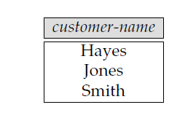
Query
Find all customers who have both a loan and an account.
The borrower relation
The depositor Relation
Πcustomer-name (depositor)
Πcustomer-name (borrower ) ∩
Πcustomer-name (depositor)
Πcustomer-name (borrower )

Slide 33
SELECT * FROM Info
INTERSECT
SELECT * FROM Demo;
🔎 Explanation
INTERSECT returns only the rows that exist in both Info and Demo.
Duplicate rows are automatically removed (similar to UNION).
The number of columns and their data types must match in both queries.
Not all DBMS (like MySQL) directly support INTERSECT – but Oracle, SQL Server, and PostgreSQL do. In MySQL, you simulate it using INNER JOIN or IN

Slide 34
Table: Info
ID | Name | City
1 | Alice | Dhaka
2 | Rashed | Rajshahi
3 | Obony | Khulna
Table: Demo
ID | Name | City
2 | Rashed | Rajshahi
4 | Karim | Dhaka
5 | Nabila | Sylhet

Slide 35
SELECT * FROM Info
INTERSECT
SELECT * FROM Demo;
ID | Name | City
2 | Rashed | Rajshahi

Slide 36
Equivalent in MySQL (since INTERSECT is not supported)
SELECT * FROM Info
INNER JOIN Demo
USING (ID, Name, City);

Slide 37
Join operation

Slide 38
What is a JOIN? A join combines rows from two (or more) tables based on a related column (the join key). General form SELECT ... FROM A JOIN B ON A.key = B.key Without a condition (CROSS JOIN), you get the Cartesian product (every row of A with every row of B

Slide 39
INNER JOIN Returns only the rows where the join condition matches in both tables LEFT OUTER JOINAll Rows from the left table; matching rows from the right; non-matches on the right become NULL RIGHT OUTER JOIN Mirror image of LEFT: all rows from the right table, NULLs for missing left rows.

Slide 40
Employees
Departments
emp_id | name | dept_id
1 | Amina | 10
2 | Bilal | 20
3 | Chen | NULL
4 | Diana | 30
dept_id | dept_name
10 | Sales
20 | HR
40 | Research

Slide 41

Employees
Departments
emp_id | name | dept_id
1 | Amina | 10
2 | Bilal | 20
3 | Chen | NULL
4 | Diana | 30
dept_id | dept_name
10 | Sales
20 | HR
40 | Research
INNER JOIN
emp_id | name | dept_name
1 | Amina | Sales
2 | Bilal | HR

Slide 42
Employees
Departments
emp_id | name | dept_id
1 | Amina | 10
2 | Bilal | 20
3 | Chen | NULL
4 | Diana | 30
dept_id | dept_name
10 | Sales
20 | HR
40 | Research
LEFT OUTER JOIN
emp_id | name | dept_name
1 | Amina | Sales
2 | Bilal | HR
3 | Chen | NULL
4 | Diana | NULL

Slide 43
Employees
Departments
emp_id | name | dept_id
1 | Amina | 10
2 | Bilal | 20
3 | Chen | NULL
4 | Diana | 30
dept_id | dept_name
10 | Sales
20 | HR
40 | Research
RIGHT OUTER JOI
emp_id | name | dept_name
1 | Amina | Sales
2 | Bilal | HR
NULL | NULL | Research

Slide 44
Employees
Departments
emp_id | name | dept_id
1 | Amina | 10
2 | Bilal | 20
3 | Chen | NULL
4 | Diana | 30
dept_id | dept_name
10 | Sales
20 | HR
40 | Research
FULL OUTER JOIN
emp_id | name | dept_name
1 | Amina | Sales
2 | Bilal | HR
3 | Chen | NULL
4 | Diana | NULL
NULL | NULL | Research

Slide 45
Outer Join – Example
Relation loan
loan_number
branch_name
amount
L-170
L-230
L-260
Downtown
Redwood
Perryridge
3000
4000
1700
Relation borrower
customer_name
loan_number
Jones
Smith
Hayes
L-170
L-230
L-155

Slide 46
Outer Join – Example
Join loan borrower
loan_number
branch_name
amount
customer_name
L-170
L-230
Downtown
Redwood
3000
4000
Jones
Smith
Left Outer Join
loan borrower
loan_number
branch_name
amount
customer_name
L-170
L-230
L-260
Downtown
Redwood
Perryridge
3000
4000
1700
Jones
Smith
null

Slide 47
Outer Join – Example
Right Outer Join
loan borrower
loan_number
branch_name
amount
customer_name
L-170
L-230
L-155
Downtown
Redwood
null
3000
4000
null
Jones
Smith
Hayes
Full Outer Join
loan borrower
loan_number
branch_name
amount
customer_name
L-170
L-230
L-260
L-155
Downtown
Redwood
Perryridge
null
3000
4000
1700
null
Jones
Smith
null
Hayes

Slide 48
Table: Students
ID | Name | City
1 | Alice | Dhaka
2 | Rashed | Rajshahi
3 | Obony | Khulna
Table: Marks
ID | Subject | Score
1 | Math | 90
2 | Math | 85
3 | Math | 70

Slide 49
SELECT Students.Name, Students.City, Marks.Score
FROM Students
INNER JOIN Marks
ON Students.ID = Marks.ID;
Name | City | Score
Alice | Dhaka | 90
Rashed | Rajshahi | 85
Obony | Khulna | 70

Slide 50
Aspect | Set Operations (UNION, INTERSECT, EXCEPT) | Join Operations (INNER JOIN, LEFT JOIN, etc.)
Combination level | Combine complete result sets (rows stacked vertically). | Combine columns from multiple tables (rows expanded horizontally).
Number of columns | Must be same number and type in both queries. | Can be different; columns are matched using a condition.

Slide 51
Duplicates | UNION removes duplicates, UNION ALL keeps them. | Duplicates depend on join condition (may produce Cartesian product if not careful).
Purpose | To merge two query results with the same structure. | To merge data across tables based on relationships/keys.
Output | Rows from one query added on top of rows from another. | Rows from one table combined side by side with rows from another.
Typical usage | Compare or merge results of two similar queries/tables. | Combine related data spread across different tables.

